Slide 1
Colleyville Chamber of Commerce May 27, 2020
TARRANT COUNTY, Texas
TCPH Updated: May 24th, 2020

Slide 2
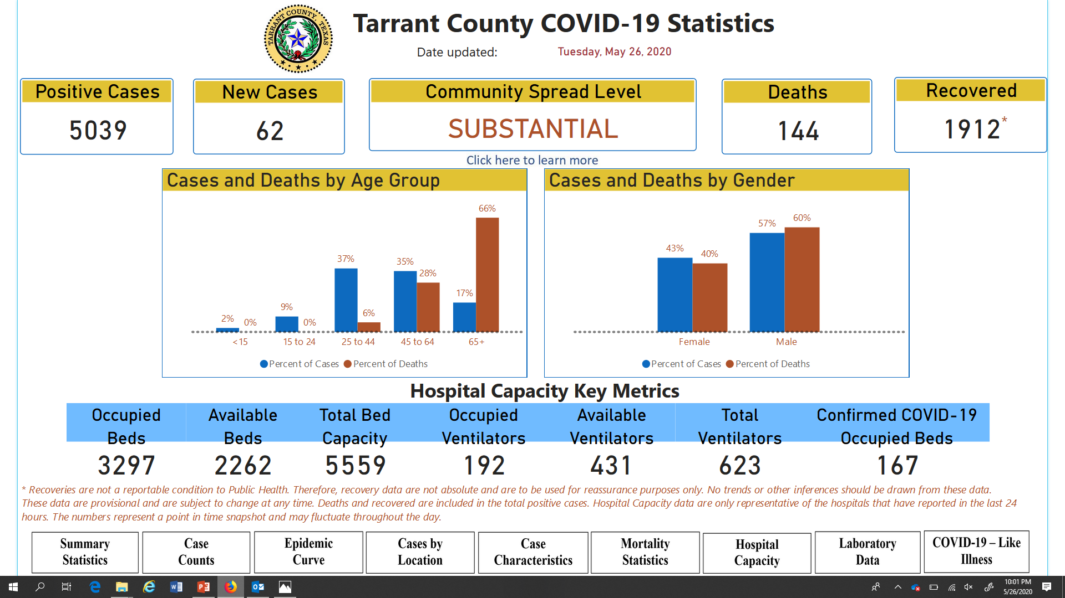
coronavirus.tarrantcounty.com

Slide 3
What is the TC data showing?
TARRANT COUNTY PUBLIC HEALTH – May 26, 2020
COVID Like Illness Trend
ILI vs CLI Trend

Slide 4
Case Trends
TARRANT COUNTY PUBLIC HEALTH – May 26, 2020
Case Trend
Case Trend - Deaths

Slide 5
Hospital trends
TARRANT COUNTY PUBLIC HEALTH

Slide 6
Take Away Messages
TARRANT COUNTY PUBLIC HEALTH
Staying @ home is still the best strategy
Social Distancing is the best tool
Wear a mask, when you go out
Seniors over 65 minimize contact
Continue to STAY HOME!

Slide 7
